Slide 1
FOUNDATIONS OF AI IN BUSINESS · CAPSTONE · LEARNING TEAM 04
Comet Growth &Positioning Advisor
Problem · Evidence · Solution
TEAM Learning Team No. 04
MEMBERS Anandita Parihar, Joy Mann, Khushi Gupta, Rudransh Tewari
August 2026
Notes:
1

Slide 2
AGENDA
What We'll Cover
Three simple parts of our project.
01
1
02
2
03
3
Problem
Evidence
Solution
The issue Comet needs to solve, explained simply.
Real facts we found and checked, all from free, public sources.
How we turn the evidence, plus AI, into one clear recommendation.
Capstone WIP · Foundations of AI in Business · Learning Team 04
2
Notes:
2

Slide 3
THE BIG PICTURE
The Problem — and Our Solution
Stated simply, in one place.
!
✓
THE PROBLEM
OUR SOLUTION
Comet is a fast-growing brand with ₹29.1cr revenue in FY25. It's chasing a share of India's $4.7B sneaker market by 2030, against giants like Nike, Adidas, Puma and New Balance.
Comet Growth &
Positioning Advisor
An AI chatbot that reviews verified evidence on awareness, price and range — then recommends what matters most for growth, and why.
Comet doesn't yet know what grows its customer base most: awareness, price, or product range. Picking the wrong one could hurt the premium image that supports its price.
It doesn't just react — it explains why, using real evidence.
Capstone WIP · Foundations of AI in Business · Learning Team 04
3
Notes:
3

Slide 4
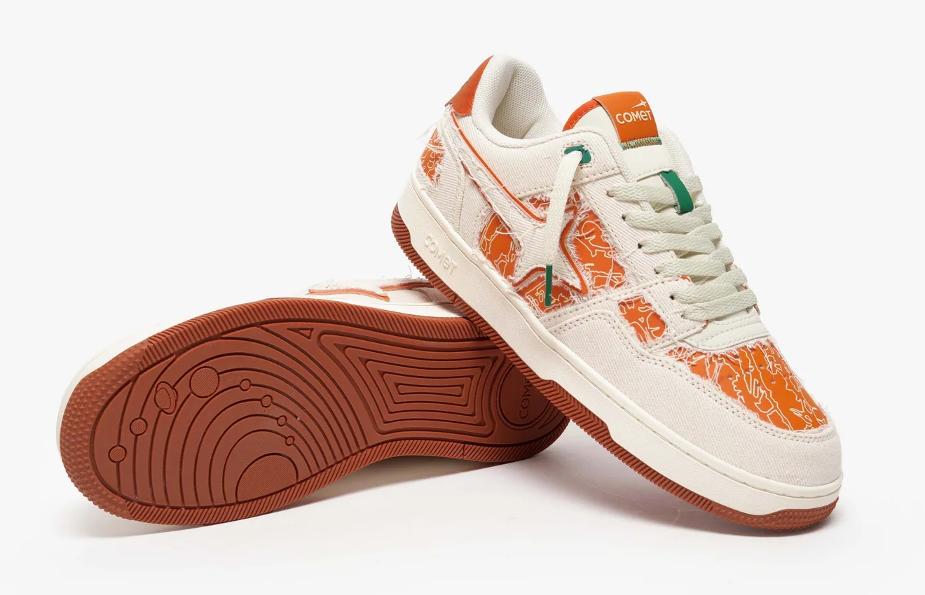
PROBLEM
What Happens If We Don't Fix This
COMET ORANGE
Comet is still growing and competing against much bigger rivals. Here's what could go wrong.
1
2
3
4
Guessing Blind
→
Diluted Identity
→
Wasted Spend
→
Falling Behind
Discounts or selling too widely can hurt the exclusive feel that supports Comet's price.
Once a premium brand image is lost, it's hard to win back.
Choosing the wrong strategy wastes money Comet — only 3 years old — can't afford to lose.
The market will grow to $4.7B, but Nike, Adidas and Puma could take most of it while Comet stays small.
If we don't act, Comet could lose its edge — even as the market keeps growing.
Capstone WIP · Foundations of AI in Business · Learning Team 04
4
Notes:
4

Slide 5
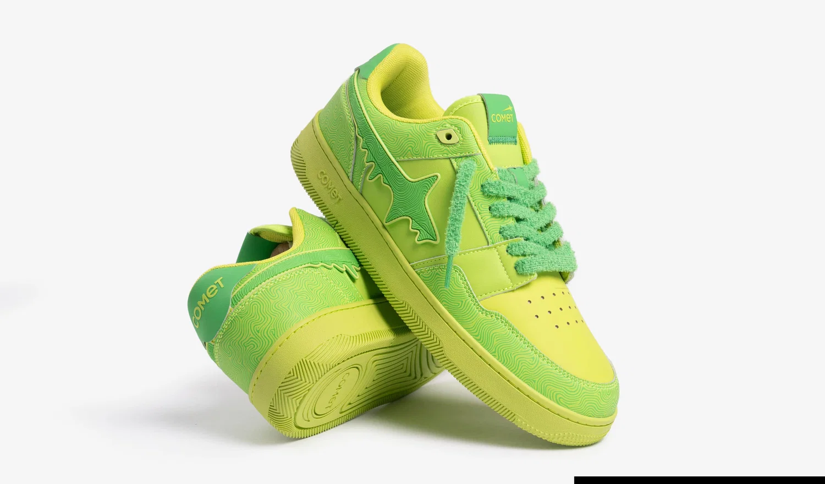
EVIDENCE
Facts We Found — Free & Public
COMET RADIOACTIVE
Every fact below comes from a free, public source, tagged with its Evidence ID from our register.
E01
E03
E04
Comet's awareness isn't directly measured. We only have estimates: ~345K Instagram followers and a fan community of 1.6 lakh+.
An investor blog says Comet customers rate it highly (NPS above 75). This shows satisfaction, not repeat purchases.
No study has tested what customers will pay for Comet's ₹4,000–5,000 shoes — we only have general market-size forecasts.
Comet [@thecometuniverse]. (n.d.). Instagram. Retrieved August 18, 2026, from instagram.com/thecometuniverse
Inc42. (2025, January 31). Can Comet stir up a sneaker revolution with its storytelling playbook? inc42.com
Elevation Capital. (2024, May 20). Investing in Comet. elevationcapital.com/investing-in-comet
Grand View Research. (n.d.). India sneakers market size & outlook, 2026–2033. Retrieved August 18, 2026, from grandviewresearch.com/horizon/outlook/sneakers-market/india
E05
E06
E08
The only public info on why buyers might pick a rival comes from Comet's own site reviews and an unclaimed CB Insights page.
Comet has opened flagship stores in Bengaluru, Delhi and Mumbai — confirmed by four news sources.
Comet currently sells 15+ product variants, all colours of one shoe model. We still need competitor numbers to compare.
FashionNetwork India. (2025a, April 22). Comet launches first flagship store in Bengaluru. in.fashionnetwork.com
FashionNetwork India. (2025b, May 12). Comet eyes offline expansion in New Delhi and Mumbai following Bengaluru debut. in.fashionnetwork.com
Indian Retailer Bureau. (2025, April 21). Comet launches first flagship sneaker store in Bangalore’s Indiranagar. Indian Retailer. indianretailer.com
Broadway Live. (n.d.). Comet shoes India—Buy Comet sneakers online. Retrieved August 18, 2026, from shop.broadwaylive.in/collections/comet
Comet. (n.d.). Comet-X Lows Orchard. Retrieved August 18, 2026, from wearcomet.com/products/x-lows-orchard
CB Insights. (n.d.). Top Comet alternatives, competitors. Retrieved August 18, 2026, from cbinsights.com/company/comet-10/alternatives-competitors
Inc42. (2025, January 31). Can Comet stir up a sneaker revolution with its storytelling playbook? inc42.com
Capstone WIP · Foundations of AI in Business · Learning Team 04
5
Notes:
5

Slide 6
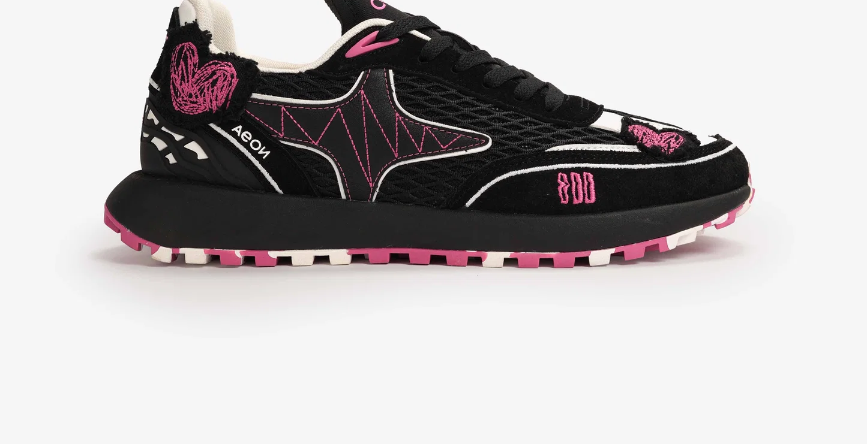
METHOD
Where AI Helped — and What We Checked
★
Where We Used AI
★
What We Checked Ourselves
Searched news and trade articles for real facts about Comet's market, customers and rivals
Turned long articles into short, plain-language summaries
Challenged our first findings and pushed us to check other angles
Helped design this presentation and the Advisor concept
Made sure every fact came from a real, free, public source
Read the full article, not just the headline
Wrote down the exact source and date, so anyone can check it
Marked anything we couldn't confirm as OPEN — no guessing
COMET × ODD NOTEVEN
Capstone WIP · Foundations of AI in Business · Learning Team 04
6
Notes:
6

Slide 7
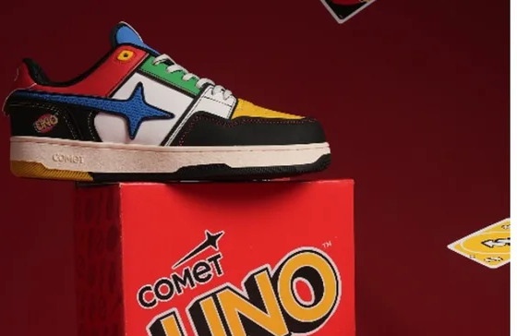
OUR AI SOLUTION
Comet Growth & Positioning Advisor
UNO × COMET
An AI chatbot built only on Comet's verified facts.
1
2
"
IN ONE LINE
Evidence-Grounded Answers
Competitor Benchmarking
“The Advisor turns our evidence on awareness, price and range into one clear answer: what to focus on, and why.”
Every claim cites an Evidence ID and a real, public source.
Compares price, product range and stores against the top 4 rivals.
3
4
Hypothesis Testing
Evidence-Gap Flagging
It doesn't just react — it explains why, with evidence.
Weighs awareness, price and range side by side.
Tells management exactly what isn't known yet.
Capstone WIP · Foundations of AI in Business · Learning Team 04
7
Notes:
7

Slide 8
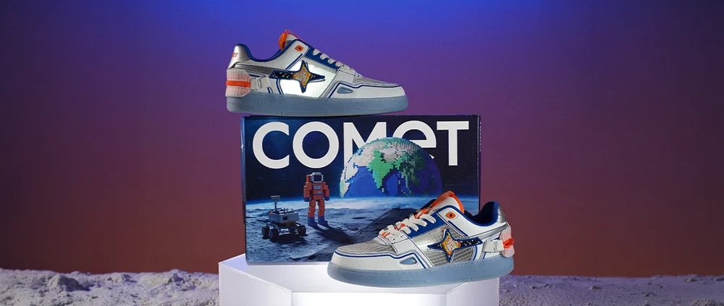
OUR AI SOLUTION
See It In Action
COMET ROCKETMAN
Management asks a question. The Advisor answers using only verified evidence — and flags what's still open.
YOU
What It Weighs Every Time
We're raising prices 8% next quarter. Can customers absorb that?
Awareness signals
ADVISOR
Price sensitivity
No study has tested what customers will pay in this price range (E04). I can't confirm if they'll accept the increase.
Product range fit
YOU
Competitor benchmark
What do we actually know about loyalty, then?
Evidence confidence
ADVISOR
Customers rate us highly (E03) and our online community is growing (E01) — but neither tells us if an 8% price rise is safe. I'd recommend a pricing study first.
Every answer points back to a verified Evidence ID or flags an open gap — not a guess.
Capstone WIP · Foundations of AI in Business · Learning Team 04
8
Notes:
8

Slide 9
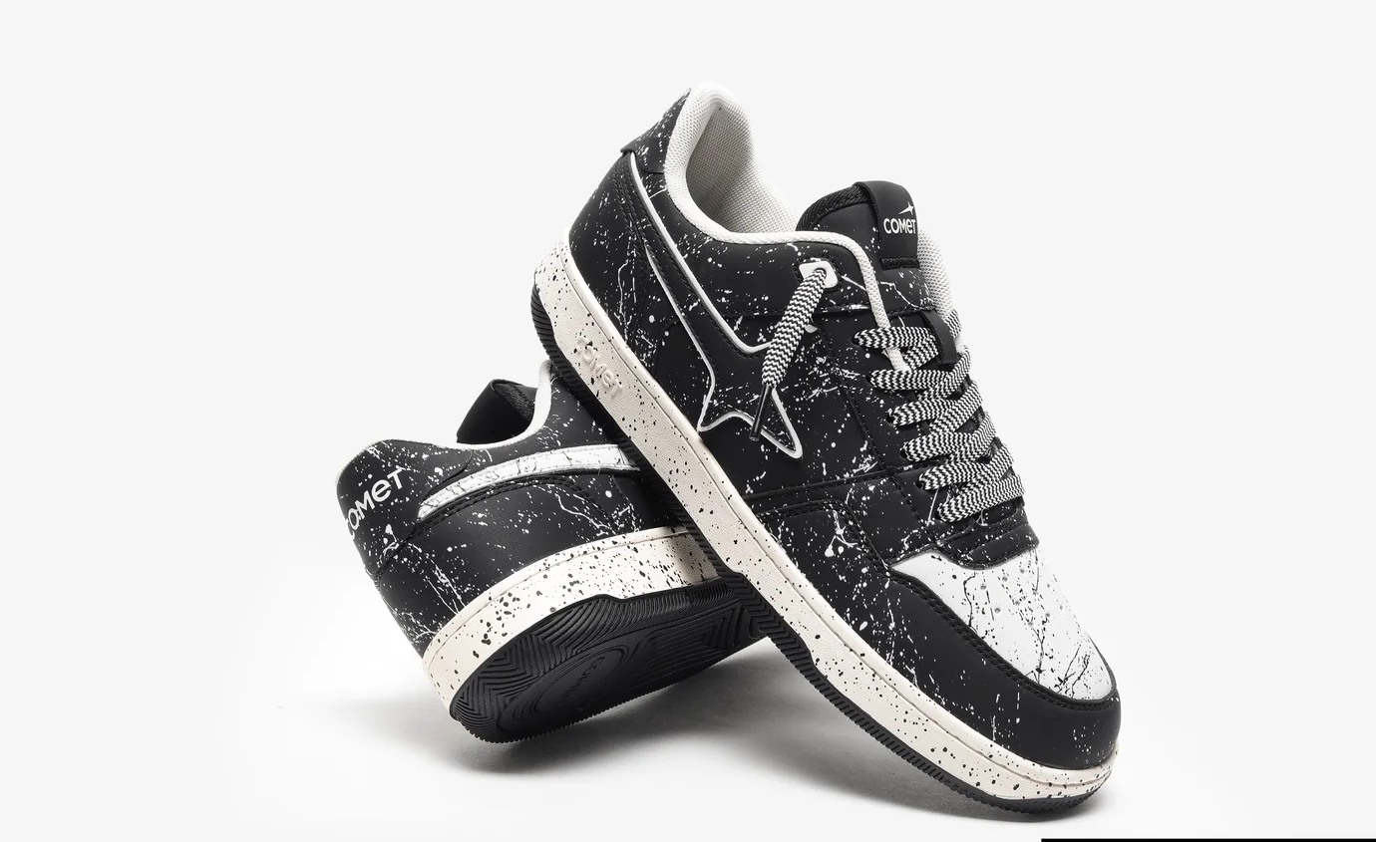
NEXT STEPS
From Evidence to Recommendation
1
Close the evidence gaps
Run a pricing study and get access to internal customer data.
2
Test the Advisor against real scenarios
See how it reasons through a pricing change or a new competitor move.
3
Bring one clear growth recommendation
Share which area — awareness, price, or range — Comet should focus on, in Session 7.
Thank you — questions welcome.
COMET DECIBEL
Notes:
9

